Slide 1
C322 Final Project
Christina, Maddi, James

Slide 2
Online Clothing Shop
We have created an online customizable clothing shop!
Our shop is responsible for creating the clothes.
Users are able to:
Sign up for our service and notifications
Order and pay for different clothing combinations
Our shop utilizes the decorator, observer, factory, and strategy design patterns.

Slide 3
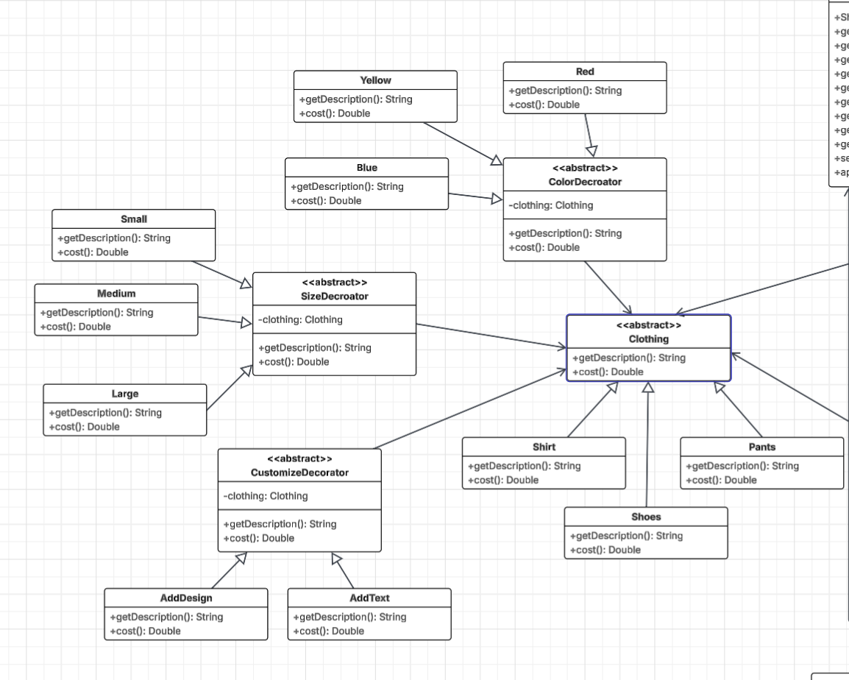
Decorator Pattern UML
Allows for easy customization
Wraps objects around other objects to modify their behavior

Slide 4
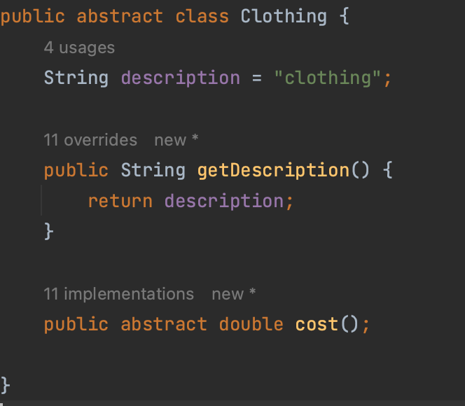
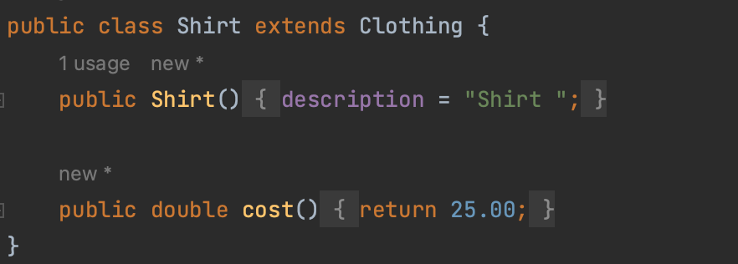
Decorator Pattern
Clothing is our abstract base class, from there, there are three classes that extend this: Shirt, Pants, and Shoes

Slide 5
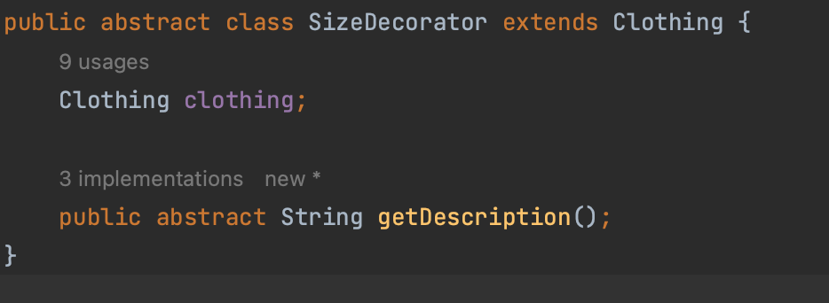
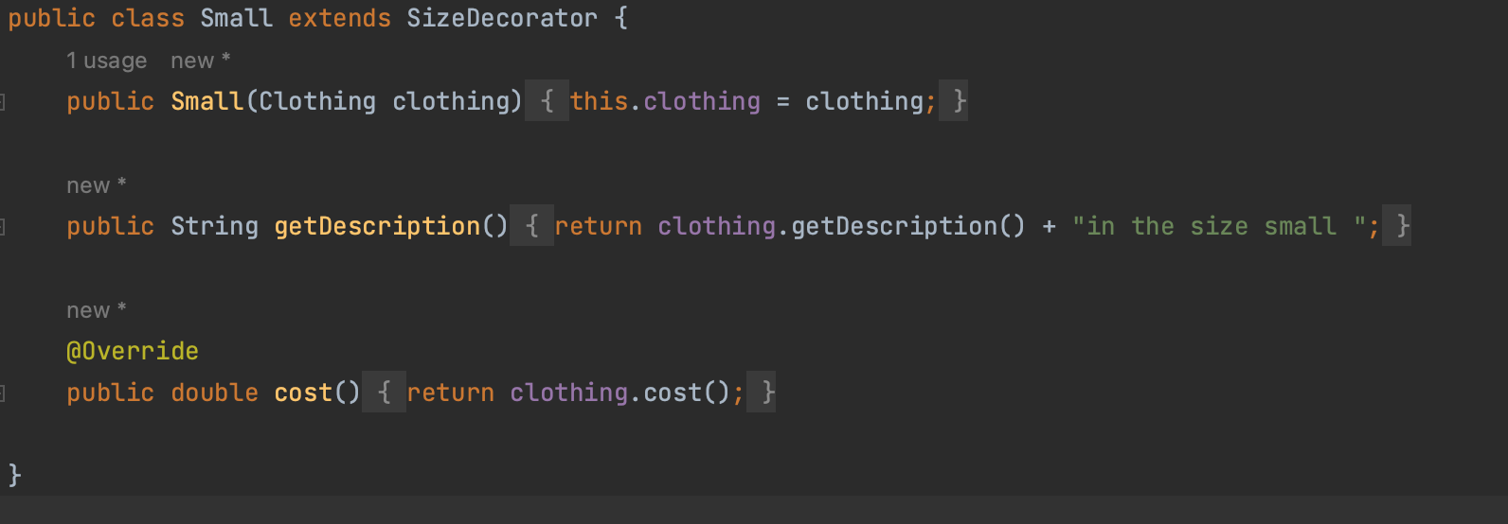
Decorator Pattern
There are three decorator classes: size decorator, customize decorator, and color decorator
Users are able to choose three sizes: small, medium, or large
They can pick three colors for their clothing: red, yellow, or blue
They can also add a custom design or text to their clothing

Slide 6
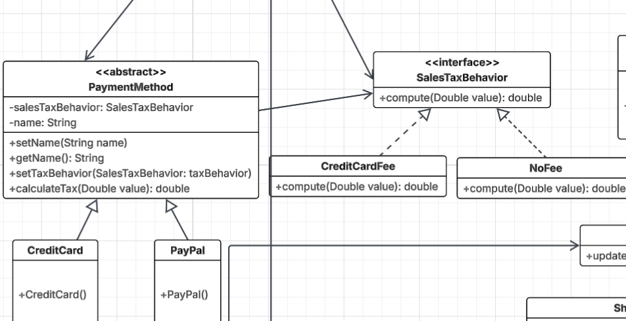
Strategy Design Pattern
Users are able to change behavior at runtime
Benefits from loose coupling

Slide 7
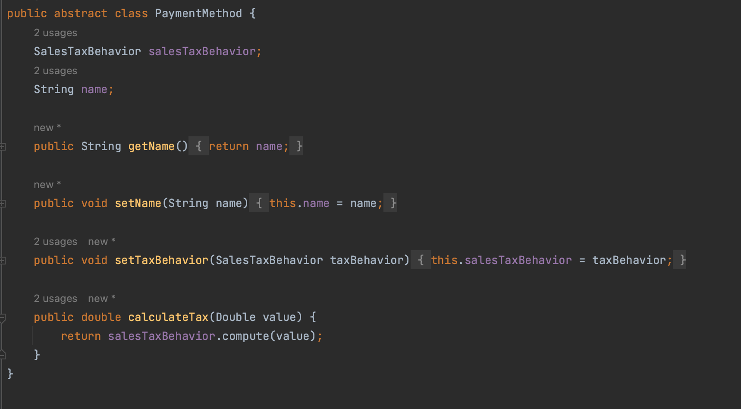
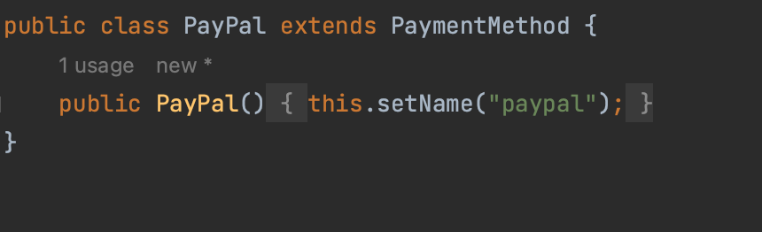
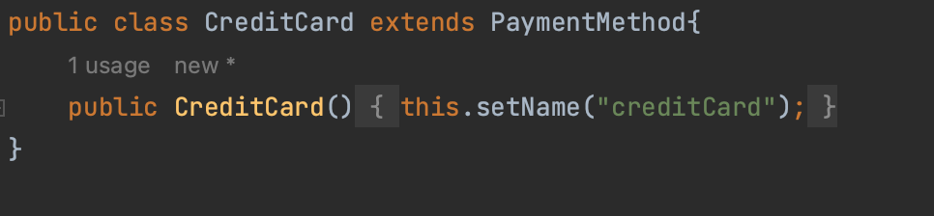
Strategy Design Pattern
Payment Method is our abstract class, we have two payment methods available: paypal and credit card
Each payment method will have a different tax behavior

Slide 8
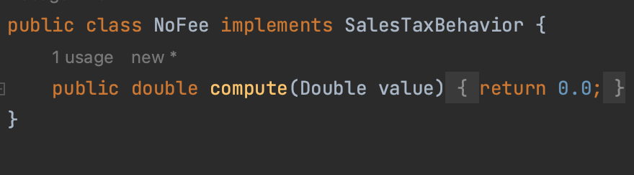
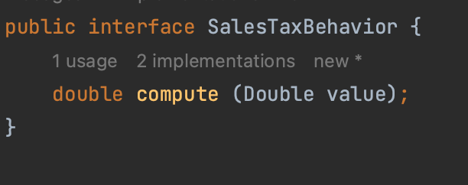
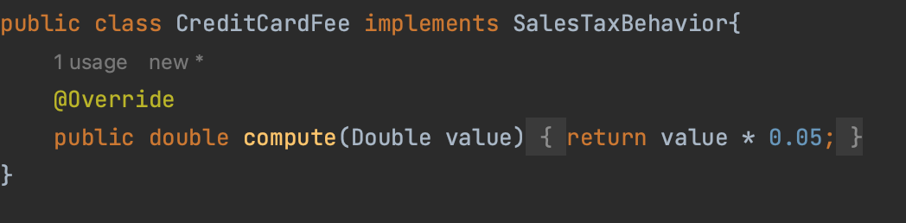
Strategy Design Pattern
There are two different tax behaviors: a 5% fee for purchases made with a credit card, and no fee for all other options

Slide 9
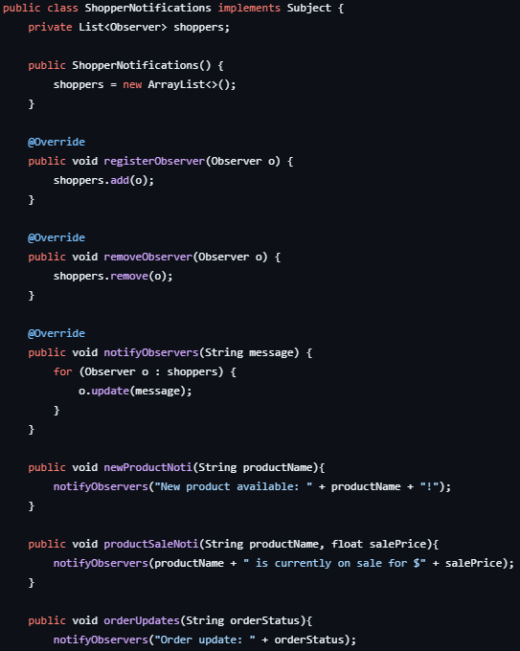


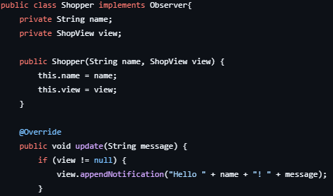
Observer Pattern Code
Observer Interface: defines update method for classes to receive notifications
Subject Interface: registers, removes, and notifies shoppers
Shopper Class: ensures each shopper receives updates from ShopperNotifications
ShopperNotifications: stores ArrayList of shoppers and notifies them

Slide 10
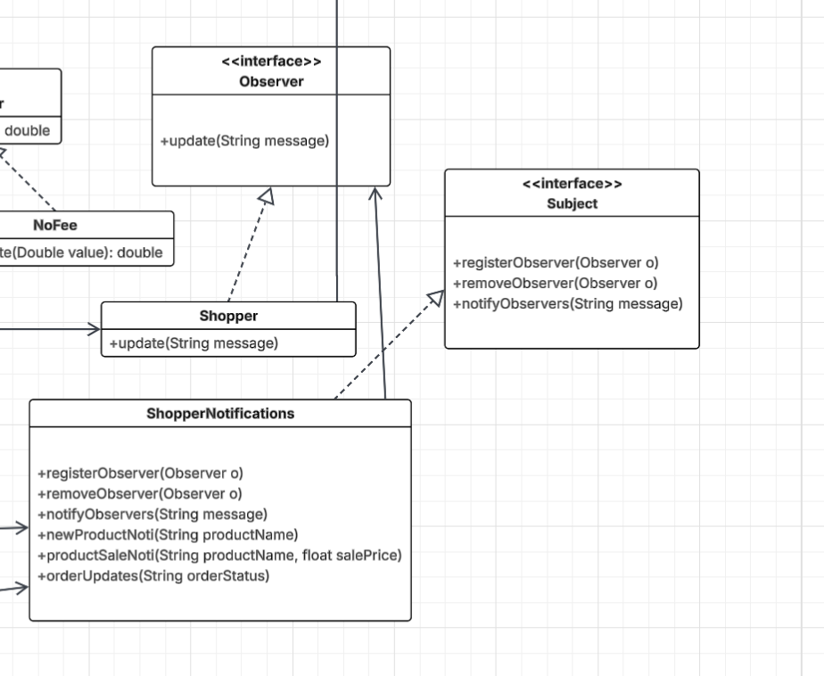
Observer Pattern UML
Shopper implements Observer interface
ShopperNotifcations implements subject interface
Registers and maintains a list of shoppers
Notifies shoppers for sales, new products, and order updates

Slide 11
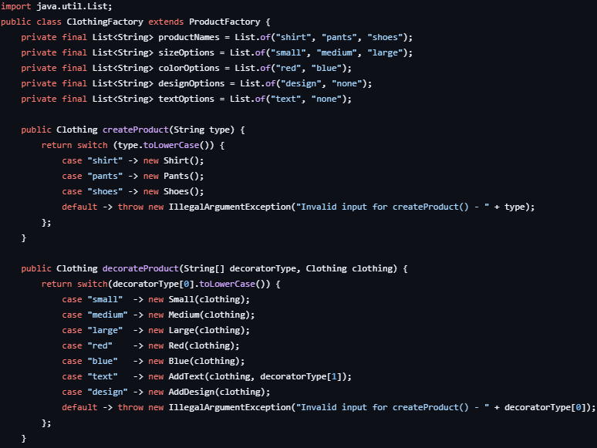
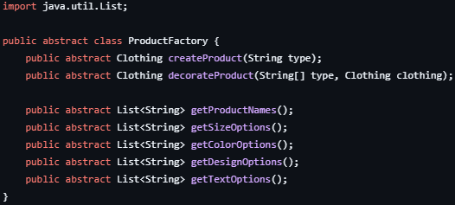
Factory Pattern Code
ProductFactory defines behavior for other factories to create and customize products
ClothingFactory extends ProductFactory and creates and allows for clothing to be created and decorated

Slide 12
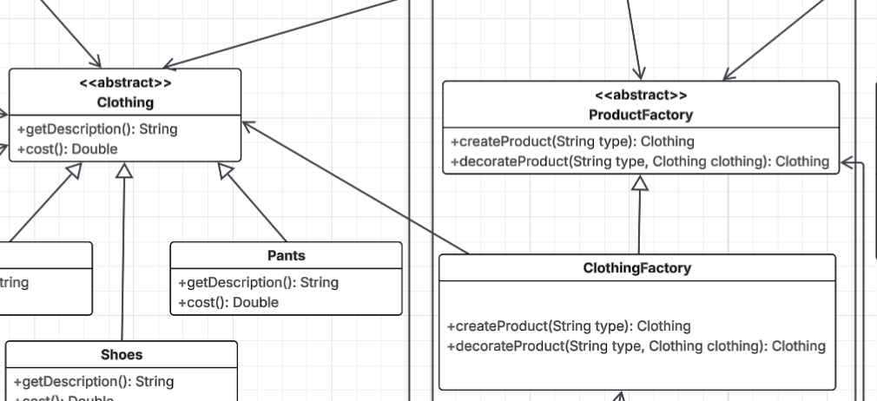
Factory Pattern UML
ClothingFactory extends ProductFactory
ClothingFactory is associated with and produces Clothing types
ShopModel, ShopController, and ShopView all use ProductFactory

Slide 13
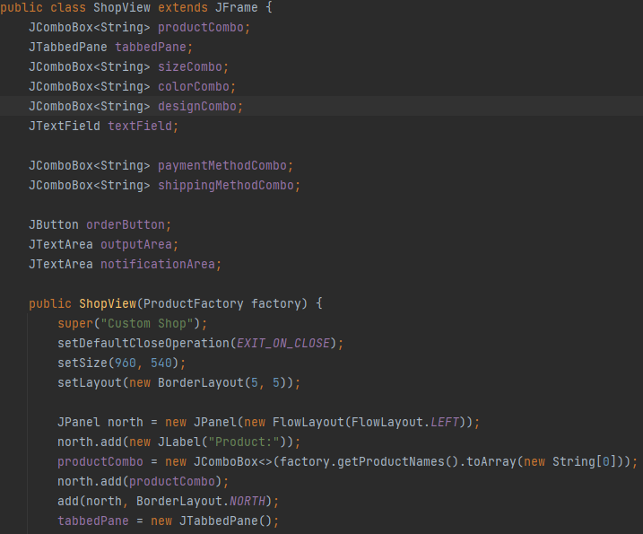
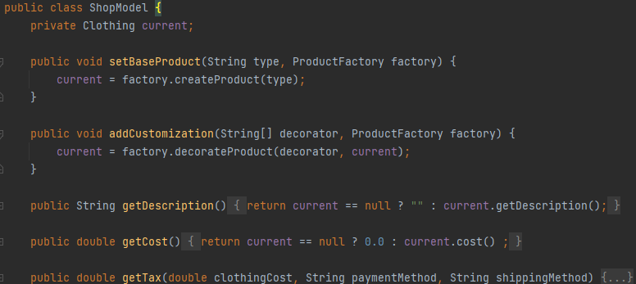
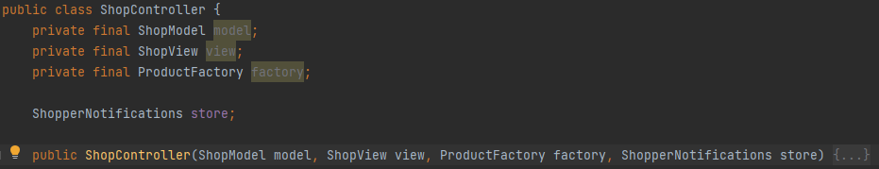
Model-View-Controller Pattern (GUI)
Implemented GUI with Model-View-Controller Pattern.

Slide 14
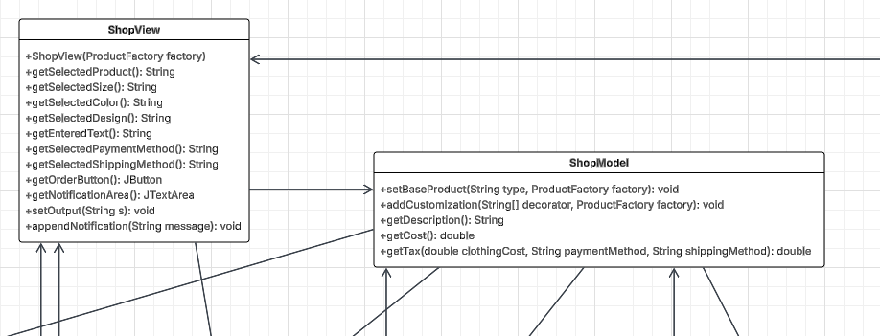
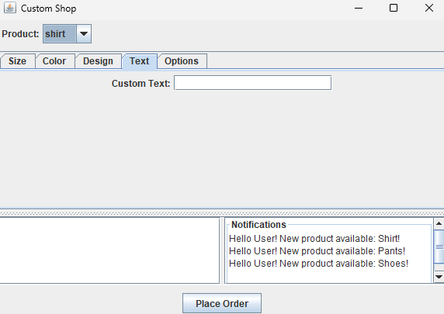
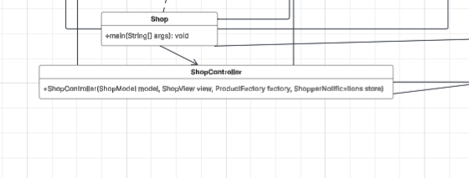
Model-View-Controller Pattern (GUI)
Model: manages logic and rules of application
View: displays data to user
Controller: handles user input, updates model

Slide 15
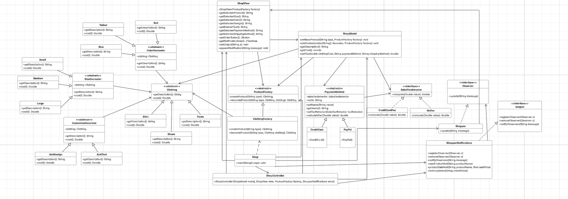
UML Overview

